Slide 1
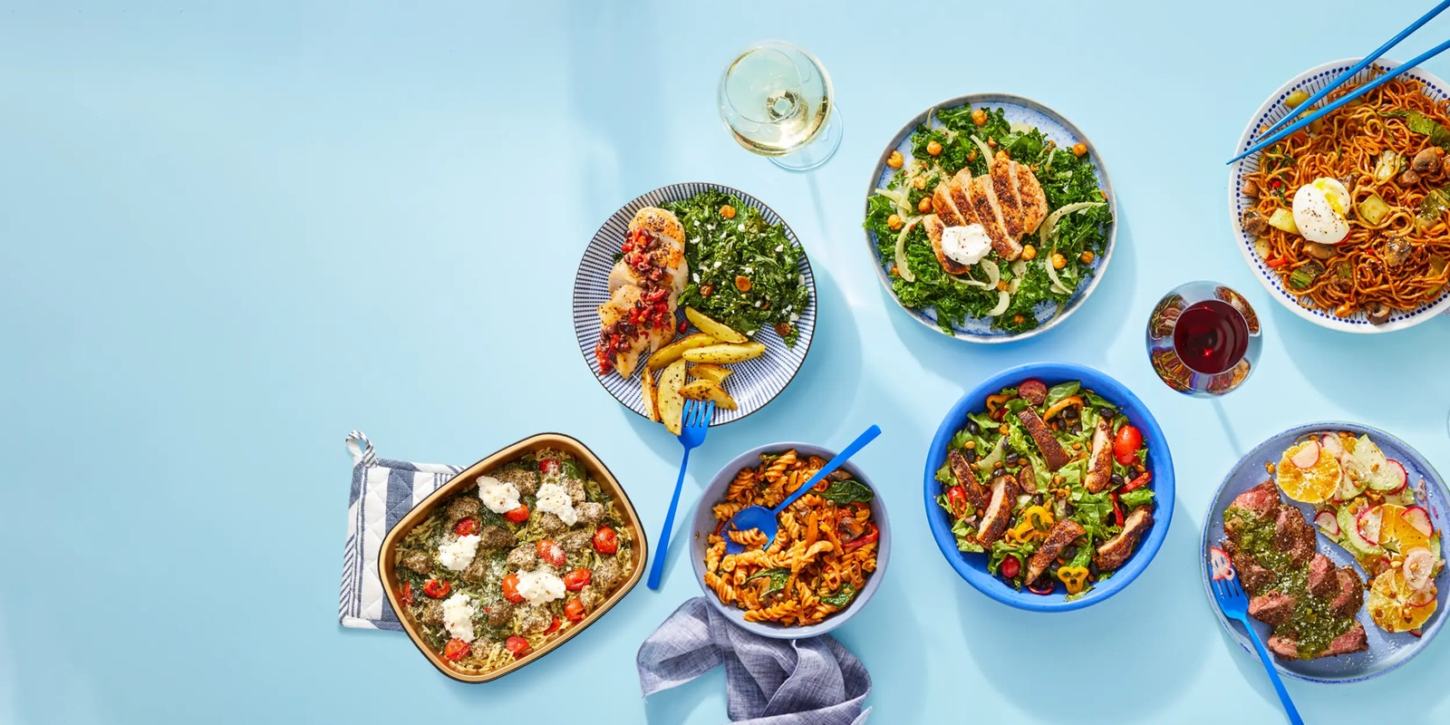


Since
2012
Blue Apron Customer Analytics
Group Member: Kshitiz Shah, Zedan Han
Date: Feb. 6, 2023
Notes:
Links:
https://www.pexels.com/photo/alcohol-architecture-bar-beer-260922/

Slide 2
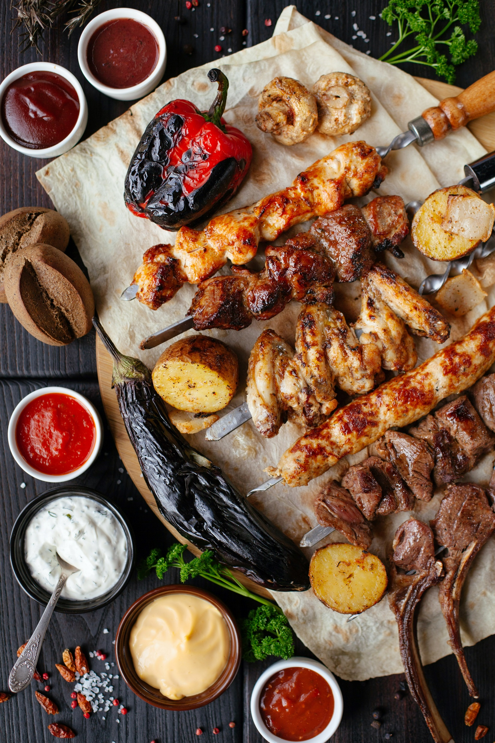

Contents
You're busy, so we're flexible
Part 1: Blue Apron Dataset Introduction
Part 2: Task 1-Predict Churn Probability
Part 3: Task 2- Predict MonthlyAddons Probability
Part 4: Task 3- Export Dataset Process
Part 5: Task 4- Blue Apron CLV Analysis
Task 4.1: Compute Baseline CLV
Task 4.2: Optimal Targeting Policy with Unlimited Budget
Task 4.3: Financial Analysis
Notes:
Links:
https://www.pexels.com/photo/chef-holding-white-tea-cup-887827/https://www.pexels.com/photo/chef-holding-white-tea-cup-887827/

Slide 3

Part 1: Blue Apron Dataset Introduction

Slide 4
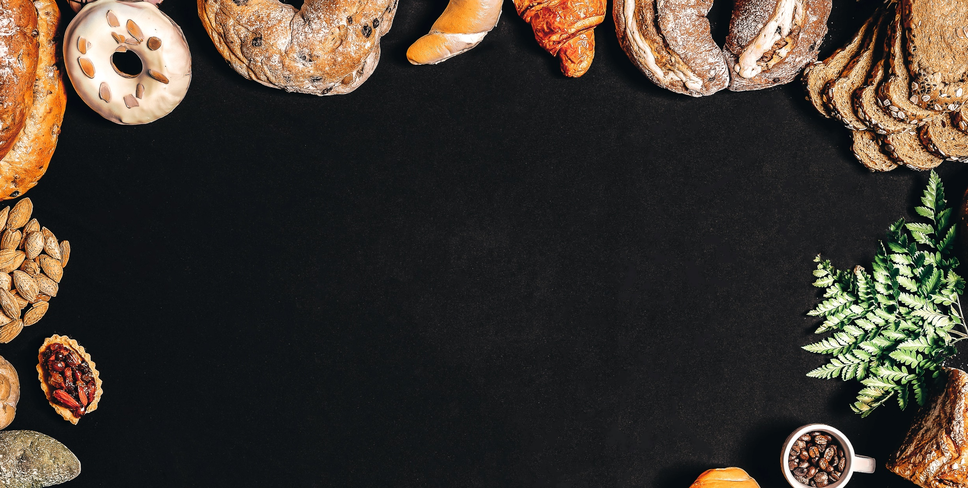

Blue Apron Dataset Introduction
Company Introduction:
Blue Apron Inc. is an American ingredient-and-recipe meal kit company headquartered in New York City, operating its services exclusively in the United States.[3] It offers weekly boxes containing ingredients, which also includes suggested recipes that must be cooked by hand by the customer using the pre-ordered ingredients.
Sustainable seafood recommended by Seafood Watch
Not fed antibiotics or hormones
Non-GMO ingredients
Dataset Introduction:
The dataset records a random sample of Blue Apron’s subscribers’ activity (∼22,400 individuals) during Jan 2019.
Attribute Information:
Customerid: unique customer identifier Urban: =1 if customer is located in urban area, =0 otherwise
Menu: type of food (healthy, ethnic, convenience) Frequency: frequency of meal delivery (once-a-week, twice-a-week, once-a-month)
PartySize: number of portions included on each delivery (2,3,4,5,6) MonthlyBasePayment: plan cost (function of frequency, menu, partysize)
Rating: customer’s rating of the service, 1 (worst) - 5 (best)
Churn: =1 if customer churned during sample period, =0 otherwise
Tenure: number of months customer has been with the company (up to end of sample period)
MonthlyAddons: amount spent on add-ons to plan (eg, additional portions, condiments, sides, etc) during sample period
4

Slide 5
Part 2: Task 1-Predict Churn Probability

Slide 6
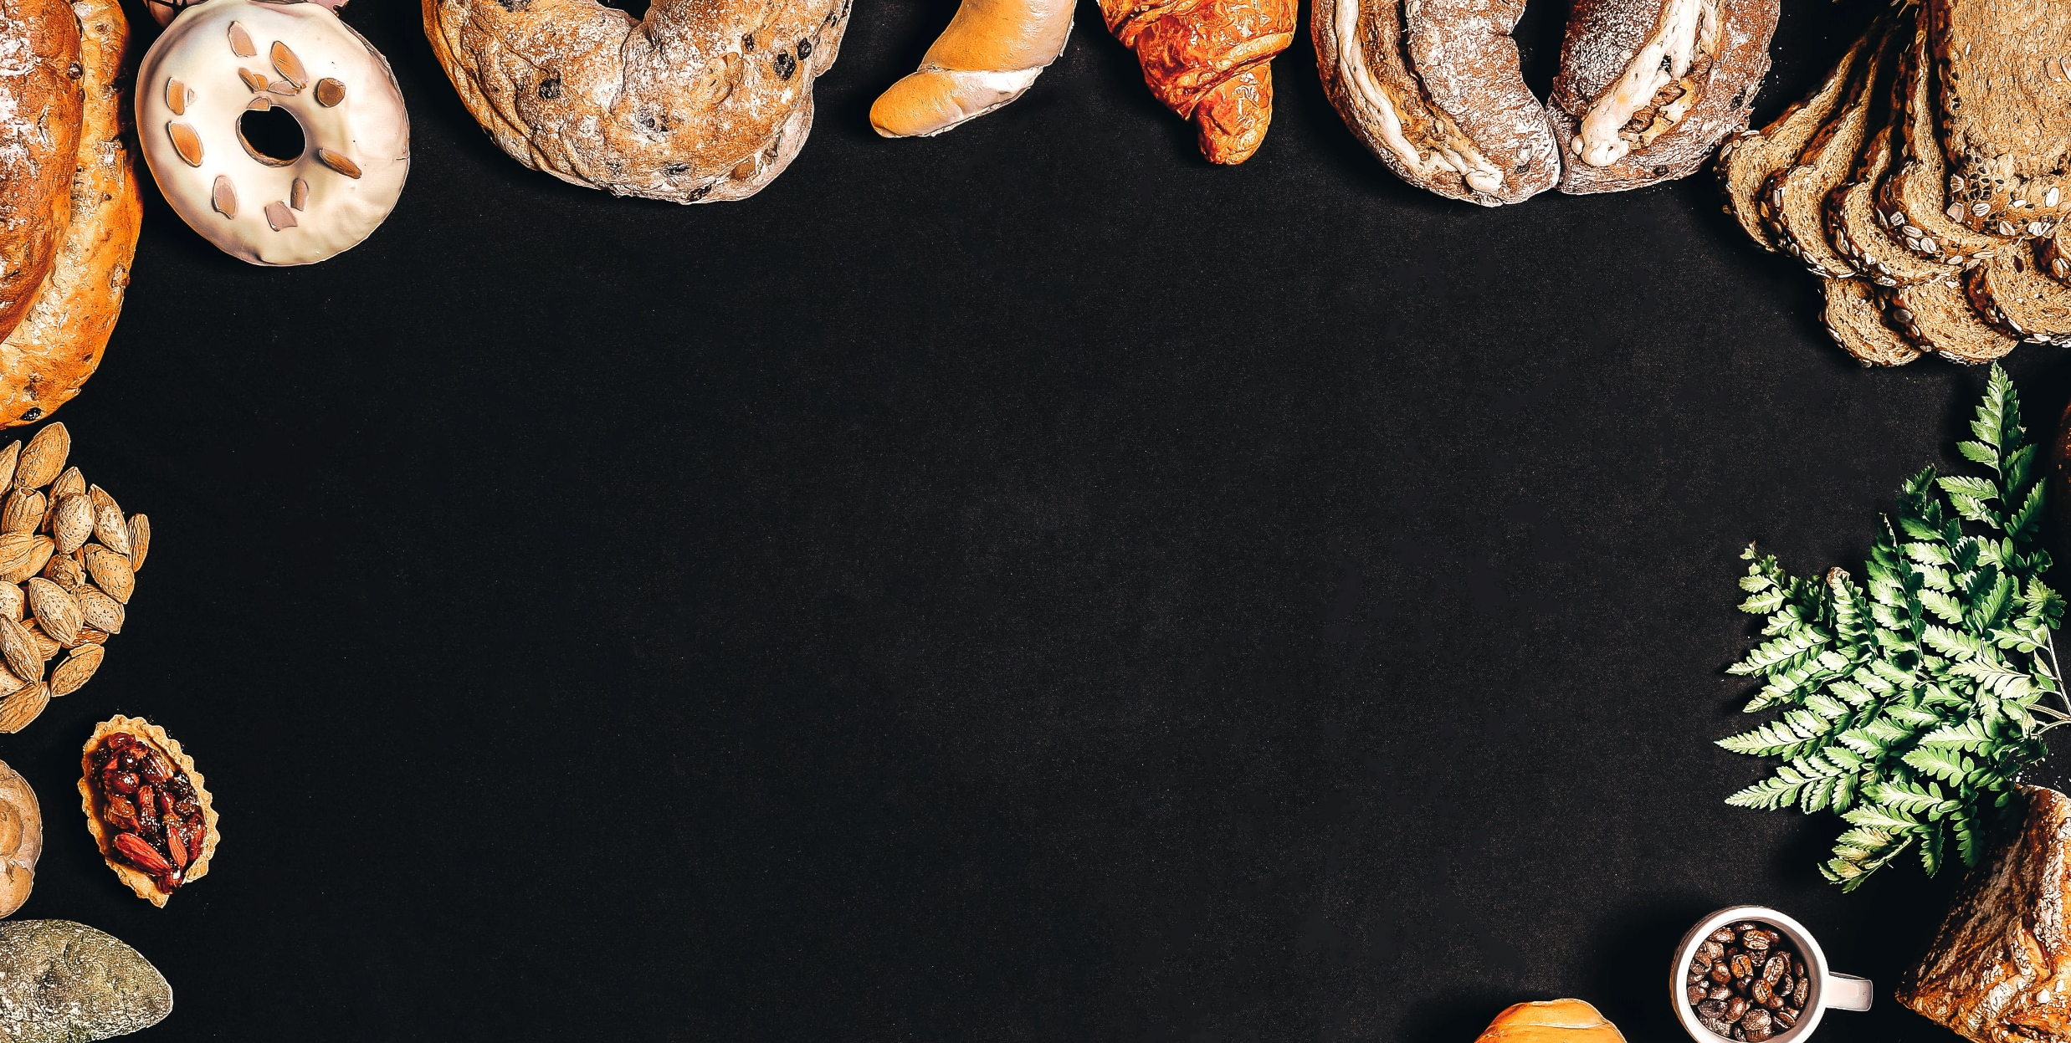
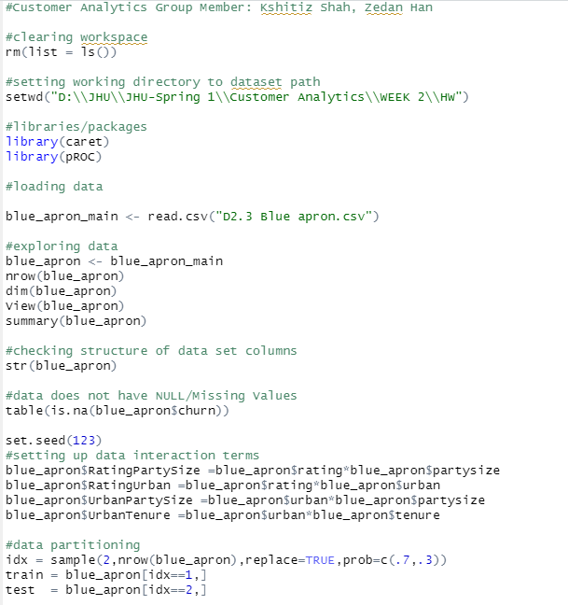
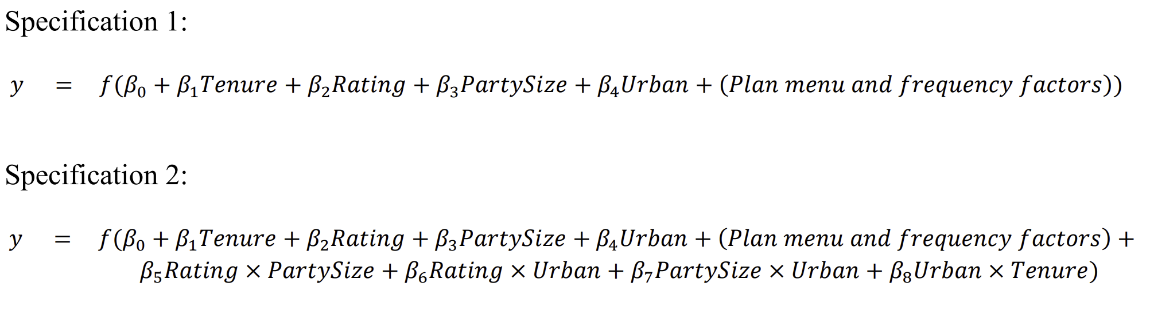
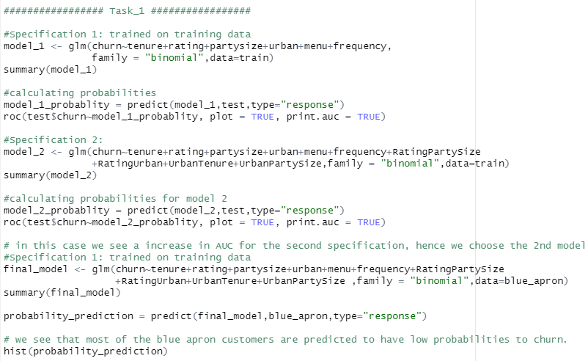
Task 1: Predict Churn Probability
We use a 70/30 training/validation to split the dataset. Then, we calculate the AUC of this two model to determinw which model is better for us to use.
6

Slide 7
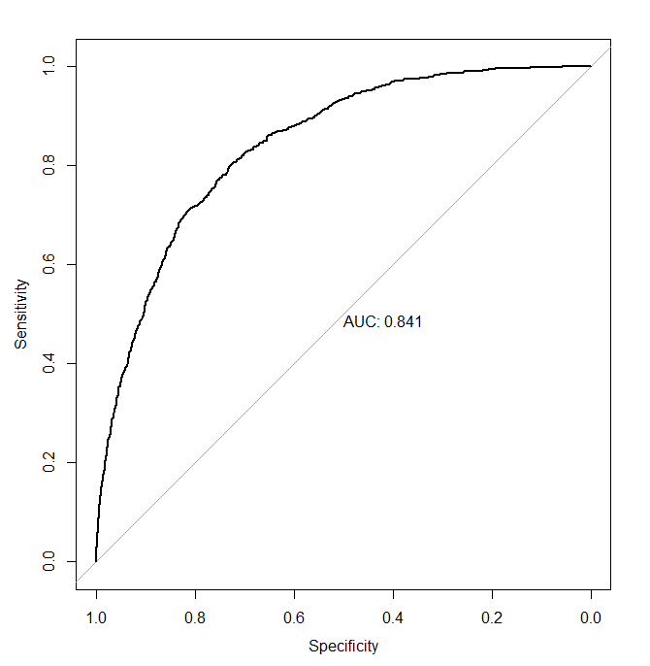
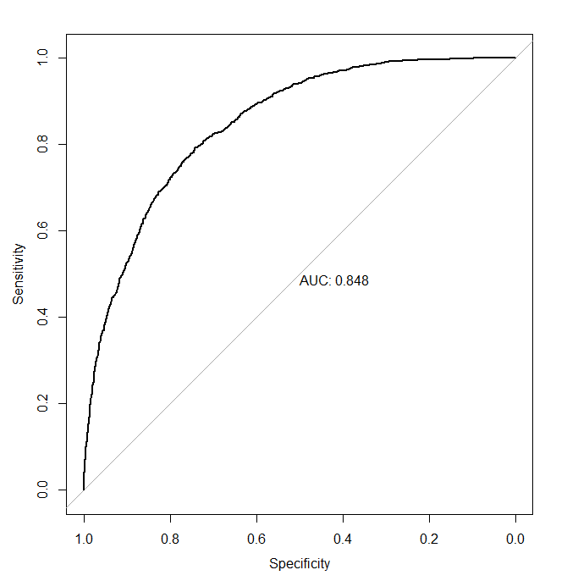
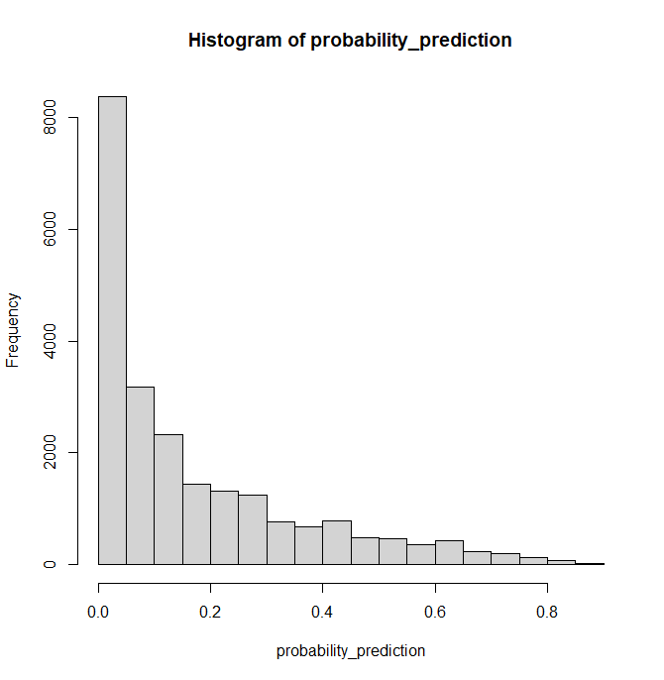
Task 1: Predict Churn Probability
The AUC for model 1 is 0.841; that of model 2 is 0.848. Thus, we prefer model 2 which has a higher AUC. Also, we draw the histogram of model 2; and we see that most of the blue apron customers are predicted to have low probabilities to churn.
Model 1 AUC
Model 2 AUC
Model 2 Histogram
✔
7

Slide 8
Part 3: Task 2- Predict MonthlyAddons Probability

Slide 9
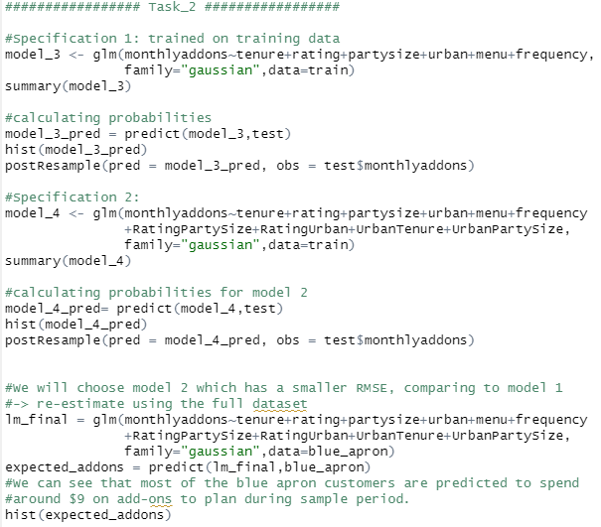
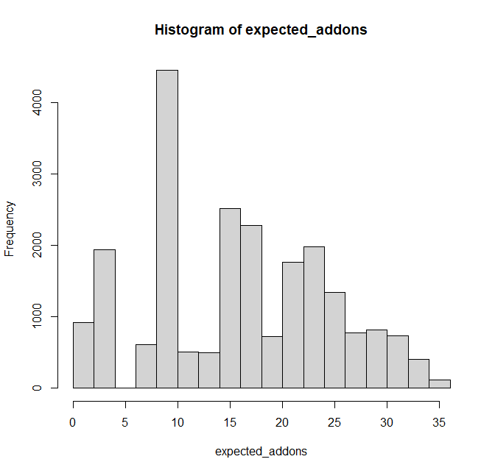
Task 2: Predict MonthlyAddons Probability
We use linear regression to estimate the two listed models using MonthlyAddons as the outcome and we choose model 2 which has a smaller RMSE. We can see that most of the blue apron customers are predicted to spend around $9 on add-ons to plan during sample period. Also, we can find that all the results are positive which means we needn’t adjust.
9

Slide 10
Part 4: Task 3- Export Dataset Process
Notes:
Links:
https://www.pexels.com/photo/chef-holding-white-tea-cup-887827/https://www.pexels.com/photo/chef-holding-white-tea-cup-887827/

Slide 11
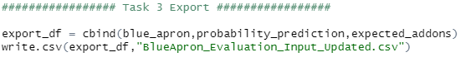
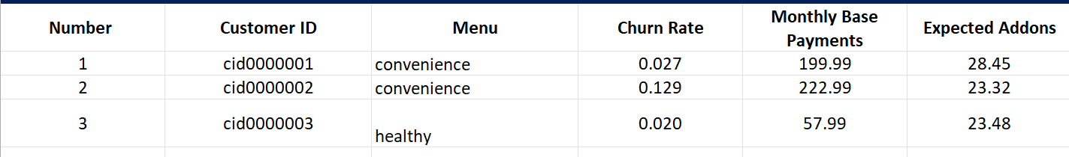
Task 3: Export Dataset Process
After finishing the prediction of churn probability and MonthlyAddons Probability, we export our dataset for further analysis of Blue Apron’s CLV.
Export Data from R
Data Provided for CLV Analysis
11

Slide 12
Part 5: Task 4- Blue Apron CLV Analysis

Slide 13
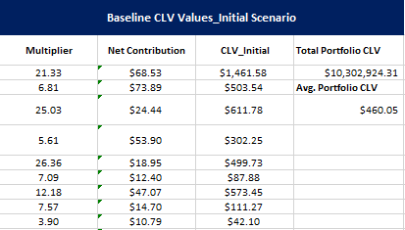
Task 4.1: Compute Baseline CLV
We compute the baseline CLV based on predicted churn rates and the given discount factor. We use the formula:
CLV = Net Contribution* 1/(1- retentionrate*discountfactor)
Baseline CLV Values_Initial Scenario
Formulas:
Multiplier: =1/(1-Discount_Factor*(1-Churn_Rate))
Net Contribution: =(Monthly_Base_Payments+Expected_Addons)*Margin
CLV_Initial: =Multiplier*Net_Contribution
Total Portfolio CLV: = sum(CLV_Initial)
13

Slide 14
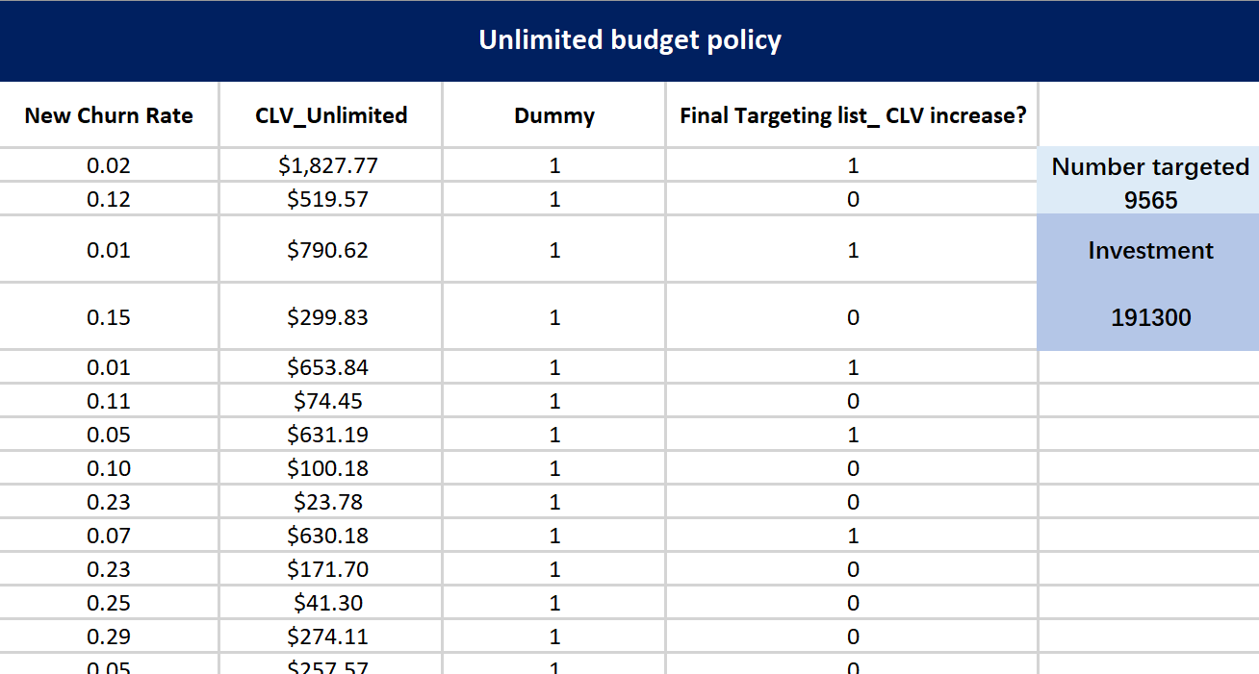
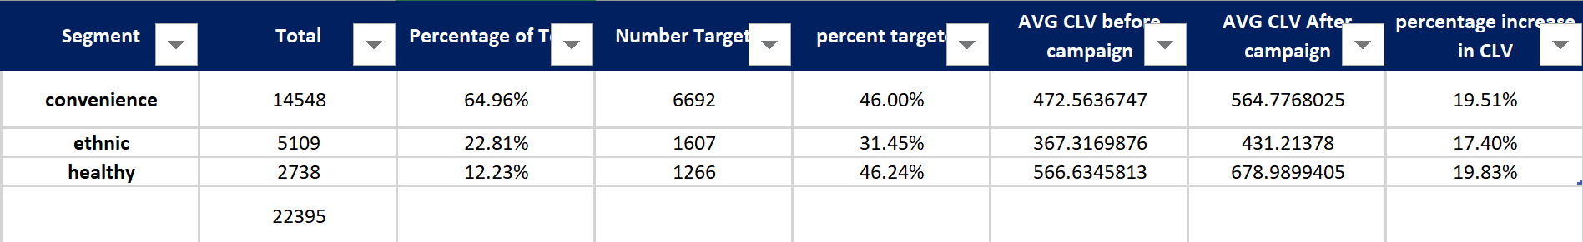
Task 4.2: Optimal Targeting Policy with Unlimited Budget
We divided our data into the segments as above to understand who our High CLV customers are. These are the customers that would be prioritized in case of a limited budget.
Since we have unlimited budget, we decide who to target based on the following criteria:
CLV_aftercampaign – CLV_beforecampaign > 20 (one time marketing cost)
Unlimited budget policy
Formulas:
New Churn Rate:=MAX(Churn_Rate-Churn_Rate_Reduced,0.0001)
CLV_Unlimited: =Net_Contribution/(1-(1- New_Churn_Rate)*Discount_Factor)-Marketing_Campaign_Cost
Final Targeting list_ CLV increase? =IF(CLV_Unlimited - CLV_Initial >20,1,0)
14

Slide 15
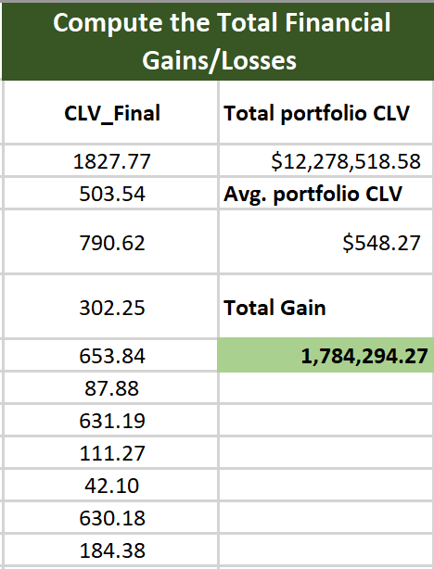
Task 4.3: Financial Analysis
We target 42% of our customers with the offer which results in a potential gain of $1.78 million.
Compute the Total Financial Gains/Losses
Unlimited budget policy
Formulas:
CLV_Final: =IF(Targeting=1, CLV_Unlimited - CLV_Initial, CLV_Initial)
Total portfolio CLV: =sum(CLV_Final)
Total Gain: = Total_Portfolio_CLV_Initial-Total_Portfolio_CLV_Unlimited- Marketing_Campaign_Cost
15

Slide 16


Thank You!

